Slide 1
Model-View-Controller Architecture

Slide 2
Give someone a program, you frustrate them for a day; teach them how to program, you frustrate them for a lifetime.
— David Leinweber
1
Notes:
<number>

Slide 3
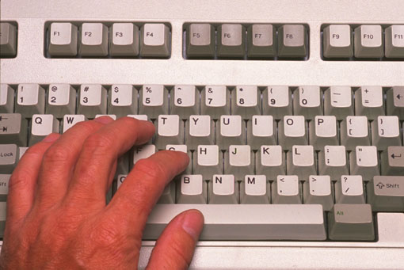
Model-View-Controller
Architecture for interactive apps
introduced by Smalltalk developers at PARC
Partitions application so that it is
scalable
maintainable
View
Model
Controller
Notes:
<number>

Slide 4
MVC
The classic design pattern
Used for data-driven user applications
Such apps juggle several tasks:
Loading and storing the data – getting it in/out of storage on request
Constructing the user interface – what the user sees
Interpreting user actions – deciding whether to modify the UI or data
These tasks are largely independent of each other
Model, view, and controller each get one task

Slide 5
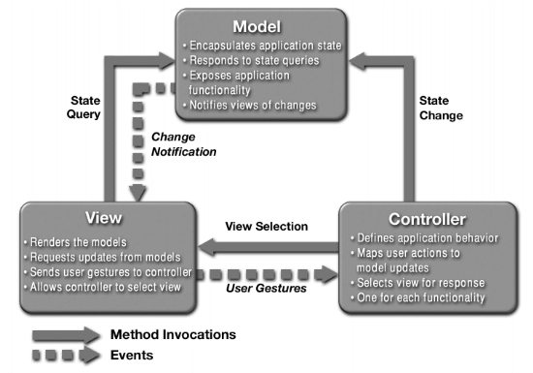
What is MVC?

Slide 6
The Model
Model
View
Controller
Most programs are supposed to do work, not just be “another pretty face”
but there are some exceptions
useful programs existed long before GUIs
The Model is the part that does the work--it models the actual problem being solved
The Model should be independent of both the Controller and the View
But it provides services (methods) for them to use
Independence gives flexibility, robustness
5
Notes:
<number>

Slide 7
Model
talks to data source to retrieve and store data
Which database table is the requested data stored in?
What SQL query will get me the data
I need?

Slide 8
The View
View
Model
Controller
Typically, the user has to be able to see, or view, what the program is doing
The View shows what the Model is doing
The View is a passive observer; it should not affect the model
The Model should be independent of the View, but (but it can provide access methods)
The View should not display what the Controller thinks is happening
<number>
Notes:
<number>

Slide 9
View
asks model for data and presents it in a user-friendly format
Would this text look better blue or red? In the bottom corner
or front and center?
Should these items go in a dropdown list or radio buttons?

Slide 10
The Controller
View
Model
Controller
The Controller decides what the model is to do
Often, the user is put in control by means of a GUI
in this case, the GUI and the Controller are often the same
The Controller and the Model can almost always be separated (what to do versus how to do it)
The design of the Controller depends on the Model
The Model should not depend on the Controller
<number>
Notes:
<number>

Slide 11
Controller
listens for the user to change data or state in the UI, notifying the model or view accordingly
The user just clicked the “hide details” button. I better tell the view.
The user just changed the event details. I better let the model know to update the data.

Slide 12
Controller Communication
View
Model
Controller
Communicates with view
determines which objects are being manipulated
e.g., which object was selected with mouse click
Calls model methods to make changes
model makes change and notifies views to update
Notes:
<number>

Slide 13
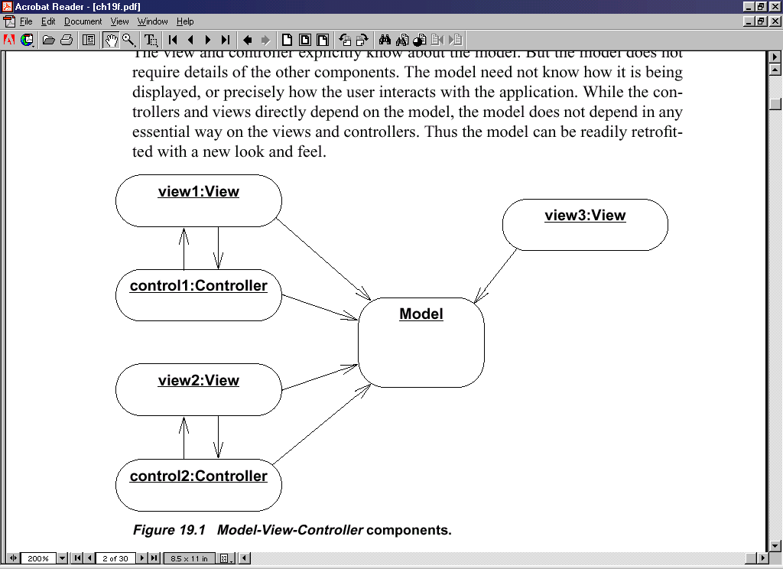
Advantages
Input processing is separated from output processing.
Controllers can be interchanged, allowing different user interaction modes.
Multiple views of the model can be supported easily.

Slide 14
Benefits of MVC
Organization of code
Maintainable, easy to find what you need
Ease of development
Build and test components independently
Flexibility
Swap out views for different presentations of the same data (ex: calendar daily, weekly, or monthly view)
Swap out models to change data storage without affecting user

Slide 15
Other ways
Combining Controller and View
Small programs
May be highly interdependent
Never mix model
Model
View
Controller

Slide 16
MVC Flow in Theory
View
Model
Controller

Slide 17
MVC Flow
In theory…
Pattern of behavior in response to inputs (controller) are independent of visual geometry (view)
Controller contacts view to interpret what input events should mean in the context of the view
In practice…
View and controller are so intertwined that they almost always occur in matched pairs (ex: command line interface)
Many architectures combine the two

Slide 18
MVC Flow in Practice
View
Model
Controller

Slide 19
Other Ways
No Model-View interaction
All interaction happens through controller
Controller talks to Model and View
Your project
View
Model
Controller

Slide 20
Why MVC?
Provides a logical structure for heavily interactive system
Adheres to good engineering design principles and practices
Information hiding, less coupling, simplicity, etc.
Delegated control style

Slide 21
Why MVC?
Combining MVC into one class or using global variables will not scale. Why?
model may have more than one view
each different & needing update on model changes
Separation eases maintenance. Why?
easy to add a new view later
may need new model info, but old views still work
can change a view later
e.g., draw shapes in 3-d
recall that the view handles selection
Notes:
<number>

Slide 22
What’s the point?
It’s just plain easier
(even if it doesn’t look it)!
Studies show that most introductory CS college students tend to clump a UI program into one big monolithic main class
Unfamiliarity stems from student tendency to program according to styles presented in textbooks and not being introduced to design principles early

Slide 23
Push vs. Pull
View
Model
Controller

Slide 24
Push vs. Pull Architecture
Push architecture
As soon as the model changes, it notifies all of the views
Pull architecture
When a view needs to be updated, it asks the model for new data

Slide 25
Push vs. Pull Architecture
Advantages for push
Guaranteed to have latest data in case something goes wrong later on
Advantages for pull
Avoid unnecessary updates, not nearly as intensive on the view

Slide 26
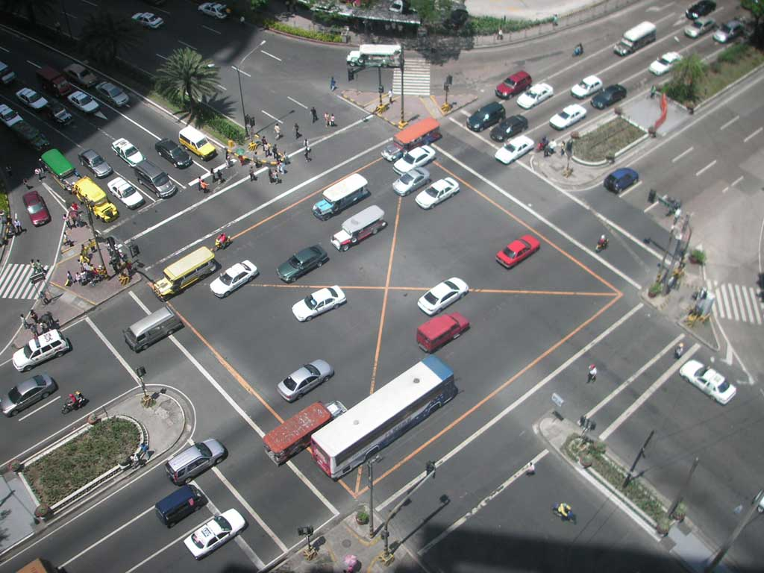
MVC Example – Traffic Signal

Slide 27
Traffic Signal – MVC
Component | Model | View | Controller
Detect cars waiting to enter intersection
Traffic lights to direct car traffic
Regulate valid traffic movements
Manual override for particular lights
Detect pedestrians waiting to cross
Pedestrian signals to direct pedestrians
External timer which triggers changes at set interval
X
X
X
X
X
X
X

Slide 28
Traffic Signal
Model
Stores current state of traffic flow
Knows current direction of traffic
Capable of skipping a light cycle
Stores whether there are cars and/or pedestrians waiting
View
Conveys information to cars and pedestrians in a specific direction
Controller
Aware of model’s current direction
Triggers methods to notify model that state should change

Slide 29
Traffic Signal Code
Model
TrafficModel – keeps track of which lights should be on and off
View
CarLight – shows relevant state of TrafficModel to cars
PedestrianLight – shows relevant state of TrafficModel to pedestrians
Controller
PedestrianButton – notifies TrafficModel that there is a pedestrian waiting
CarDetector – notifies TrafficModel that there is a car waiting
LightSwitch – enables or disables the light
Timer – regulates time in some way, possibly to skip cycles

